Slide 1
Career Interest and Technology
Name
Institution
Date

Slide 2
Career Pursuit
A Super Security officer;
Enhances security
Makes security decisions for an organization
Plans on security measures
Notes:
The Super Security officer is responsible for improving and enhancing physical security and increasing IT security. As a Super Security Officer, I should be able to determine and make decisions on an organization's protection goals and objectives. In making security decisions, I have to ensure that they align with the organization's strategic plan. Another important function of Super Security is to work with other supervisors to prioritize safety requirements and then spend according to the organization's financial instructions and restrictions. In summary, a Super Security officer's work is to oversee the security of an individual's or organization's property or data and personnel and cooperate with law enforcement agencies and other security agencies.

Slide 3
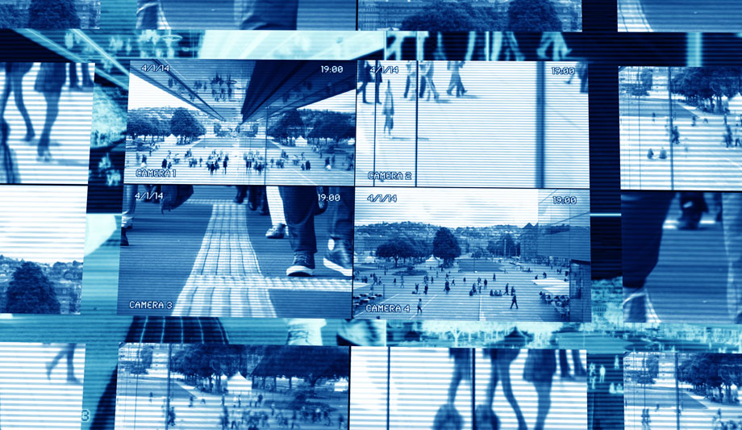
Primary technology in three years
Use of Artificial Intelligence aimed at;
Improving remote security surveillance
Ensuring real-time analysis
Ensuring 24/7 control and monitoring
Notes:
Artificial Intelligence is proving to be very important for efficient control and monitoring of remote equipment and facilities. Furthermore, the real-time analysis of remote videos and information sources is improving rapidly, thus increasing security surveillance efficiency. There is an expectation of rapid development of supervision and hardened machine learning algorithms. These algorithms will further contribute to artificial intelligence-based visual recognition systems, which will define the future of remote security surveillance (Radulov, 2019). Cameras with night vision and high imaging capabilities will be adopted to act as sensors for the AI-based video recognition systems. This development will enable 24/7 monitoring of equipment, sites, and remote properties. This is likely to be achieved because many companies are committed to integrating machine captions with real-time video data from remote sites and devices.

Slide 4
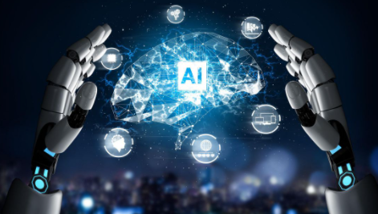
Continuation…
Encouraging the use of SCADA for efficiency
Incorporating Artificial intelligence-based cameras
Notes:
It was complicated for security personnel to apply artificial intelligence in their operations in recent years, but now it is very efficient. It is embedded in the chipset and ready to operate through supervisory control and data acquisition. SCADA helps in integrating sensors, meters, and equipment to provide real-time data and information. This technology will be a milestone in the security sector since many large organizations in remote locations will be able to integrate physical and network security systems and get a perfect 360-degree view. Using Artificial Intelligence will be affordable and will provide analytical performance capable of detecting objects with obstacles along their way. The AI will also involve the use of Artificial Intelligence-based cameras that can accurately identify objects, such as vehicles and people, and capture their characteristics.

Slide 5
Other Technologies in Ten Years
Use of cloud computing aimed at;
Improving intelligence in security operations
Accessing the surveillance control system
Integrating physical and IT security
Notes:
Clouding computing is a new trend that is expected to dominate all the fields that require intelligence operations. I can foresee that this trend will have dominated the security sector in ten years, especially as the industry-wide adoption rate continues to rise. It is expected that the use of clouding technology, such as video and access control systems, will grow substantially over the years (Senyo, Addae & Boateng, 2018). Large organizations are experiencing the benefits of cloud computing as part of their security strategy as it has enhanced remote capabilities and automatic software updates. Cloud computing is expected to bring about convergence as both small and medium-sized businesses, and large enterprise organizations will look to the cloud for their activities and data for a common platform aimed at integrating physical and information security.

Slide 6
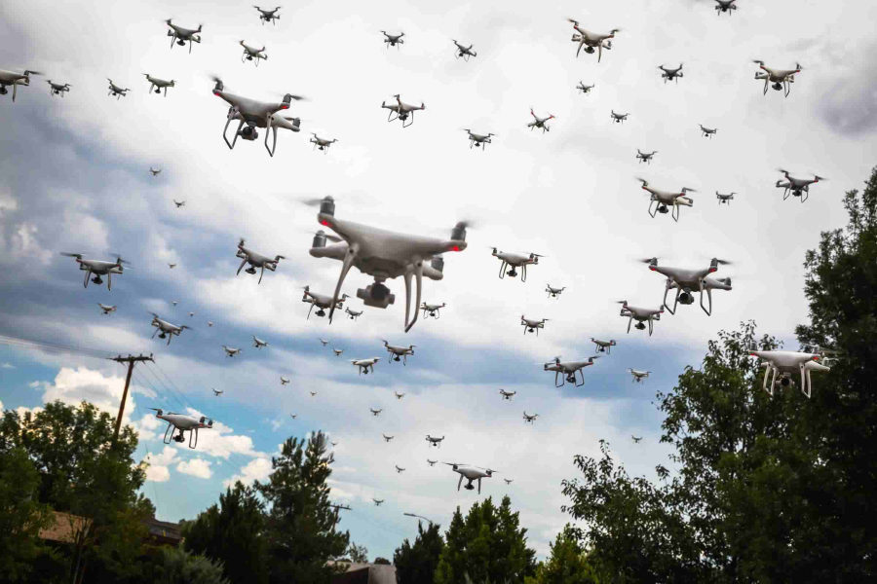
Continuation…
Use of improved drone detections;
With high-resolution camera
With more efficient GPS and parts
With improved software and application
Capable of ensuring data security
Notes:
The technology used for all drones is evolving rapidly. The latest version contains everything from the highest resolution camera for live streaming to "sense and avoid" technology to ensure the drones do not crash into various objects along their path. Future drones are expected to have more improved parts from GPS, batteries, data link, compass, and remote control, making them more efficient. Drone software and application development will continue to a point where it will be possible to manage drones via pre-programmed routes automatically. The drone itself can avoid any obstacles along the way. Furthermore, I expect developments in drone technology that will ensure that data collected by the drones is stored in a data environment that is compliant with the General Data Protection Regulation (GDPR) regarding personal data and record storage rules (Altawy & Youssef, 2016).

Slide 7
Continuation…
Use of virtual reality to;
Monitor and manage security activities
Reduce the cost of program simulations
Help in disaster management
https://www.youtube.com/watch?v=Z77QeFW_5dE&t=12s
Notes:
I expect virtual reality to have a major impact on state and local organizations' security. Major developments are expected in how security officers can apply virtual reality in monitoring their activities. With improved virtual reality technology, security agencies will be able to get rid of costly and ineffective simulations and implement various training programs (Turner et al. 2016). It will further help security personnel in making more informed mitigation and rescue decisions during disaster management. Virtual reality technology is being modified to help officers determine when to respond to a crisis. This development is expected to apply geographic information science (GIS) data to control catastrophic consequences resulting from natural disasters such as hurricanes and wildfires. This technology will help security teams to understand which areas are inaccessible and where more resources are needed.

Slide 8
Most Useful Social Media
Use of Twitter since;
It provides real-time information
It shares different news at once
It gives detailed information
Notes:
Super Security services relies on the use of reliable real-time information in executing their duties. Thanks to Twitter, getting real-time information is slowly being achieved as it is becoming more convenient. It is approximated that around 5000 tweets are sent every second on Twitter. Through the use of Twitter, security personnel can receive more breaking news at ago from different sources. Most of the news shared on Twitter is reliable as they are usually the latest occurrences. Therefore security personnel can get finer details of an occurrence that require their Twitter interventions since they are guaranteed the latest news and opinions compared to other social media platforms (Martinez-Rojas et al., 2018). In a few years' time use of Twitter is expected to play an active role in the security sector through the collection, dissemination, reporting, and analysis of news and information in real-time.

Slide 9
Continuation…
Tweeter might have significant contributions because:
Individual tweets are more accurate
Tweeter trends are real time-information
It allows video streaming
Notes:
Due to the use of social networks, especially Twitter, the public has become the sender of information in real-time. The securities personnel do not have to rely only on the journalists' information as individuals' news through tweets are likely to be more accurate. Furthermore, real-time information can be broadcasted worldwide and turned into breaking news very fast through tweets, replies, and mentions on Twitter. It also provides a more extensive and interactive platform; therefore, security personnel can be guided by the users' interactions. The use of Hashtags on Twitter is also very powerful, and it helps security officers to broaden their reach and engage in relevant conversations. Apart from the use of texts and images, Twitter allows the streaming of live videos, therefore solving the problem of the set 140 character limits. Twitter is revolutionizing the way we use and manage information in real-time. The faster real-time information is available for the security personnel, the faster they can detect it, and the faster they can respond.

Slide 10
Preparation for the technology revolution through;
Preparing for the potential emerging technology entails:
Using technology-based course material
Undergoing specialized training
Training on projected technology techniques
Notes:
Technology is the biggest catalyst for change, not only in the security industry but also in other sectors. Therefore, I will ensure that I go through all the relevant technology materials in the school library to understand different authors' different technology projections. Since the future of technology developments will largely involve monitoring and controlling at a comfort zone, I will train on the emerging surveillance techniques and use of new tools in other industries. For quality services, after my current course will take a short course to specialize in a specific work environment so as to be able to tackle future technologies effectively and bring more value to the organizations and agencies that I will be working for.

Slide 11
Continuation…
Being innovative and technology-oriented
Use of phone applications to familiarize
Preparing for technology challenges
Notes:
Since I expect to apply my knowledge in the future, I will focus on discovering new gaps in the current technologies. I will try to apply technology to solve all the problems I encounter in my career, consequently helping me adopt new technologies in the future without any difficulties. Through this, I will also be preparing for possible challenges in the implementation of future new technologies. I will use mobile apps to access technology related course materials. Using mobile phones should be part of the training since several apps provide courses over the phone and receive reports on progress and success rates. This is important since the school course materials may not offer all the necessary information in security technology developments. Furthermore, using mobile apps makes the training process easy, simple, and fun.

Slide 12
References
Altawy, R., & Youssef, A. M. (2016). Security, privacy, and safety aspects of civilian drones: A survey. ACM Transactions on Cyber-Physical Systems, 1(2), 1-25.
https://www.sourcesecurity.com/insights/artificial-intelligence-poised-great-strides-security-co-14733-ga.22520.html
https://www.youtube.com/watch?v=Z77QeFW_5dE&t=12s
https://www.securitymagazine.com/articles/90535-drones-and-security-the-future-of-public-space-safety
Martinez-Rojas, M., del Carmen Pardo-Ferreira, M., & Rubio-Romero, J. C. (2018). Twitter as a tool for the management and analysis of emergency situations: A systematic literature review. International Journal of Information Management, 43, 196-208.
Radulov, N. (2019). Artificial intelligence and security. Security 4.0. Security & Future, 3(1), 3-5.
Senyo, P. K., Addae, E., & Boateng, R. (2018). Cloud computing research: A review of research themes, frameworks, methods and future research directions. International Journal of Information Management, 38(1), 128-139.
Turner, C. J., Hutabarat, W., Oyekan, J., & Tiwari, A. (2016). Discrete event simulation and virtual reality use in industry: New opportunities and future trends. IEEE Transactions on Human-Machine Systems, 46(6), 882-894.

